Slide 1
Week 10-13
Image Classification

Slide 2
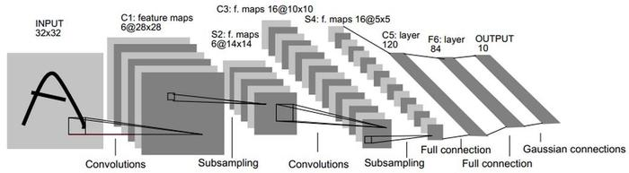
LeNet-5
Convolution
Pooling
Fully connection

Slide 3

Convolution
Feature map size: $output=\frac{input+2 ×padding −kernel}{stride}+1$

Slide 4
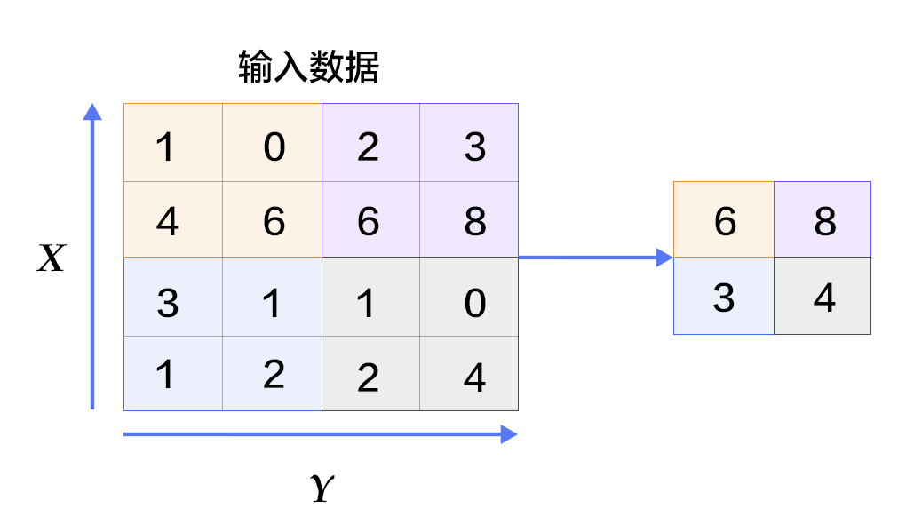
Pooling
Max pooling

Slide 5
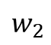
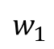
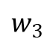
Fully connection
$$w_{1}$$
$$w_{2}$$
$$w_{3}$$
output
input

Slide 6
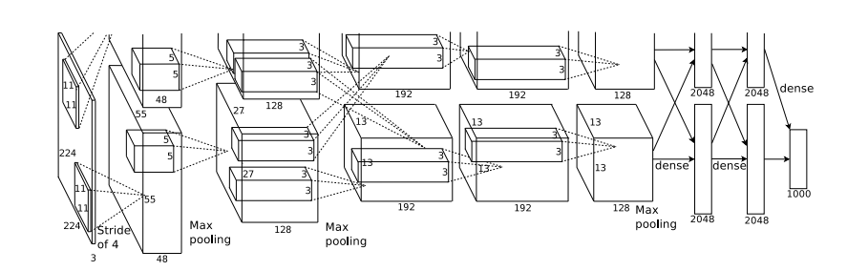
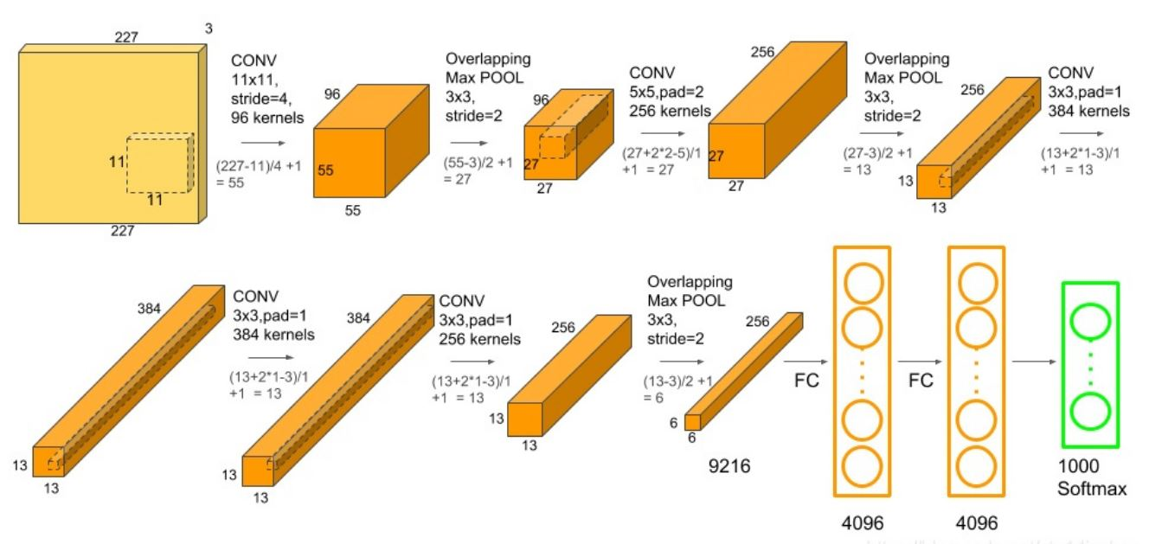
AlexNet
ReLU
Local Response Norm
Dropout

Slide 7
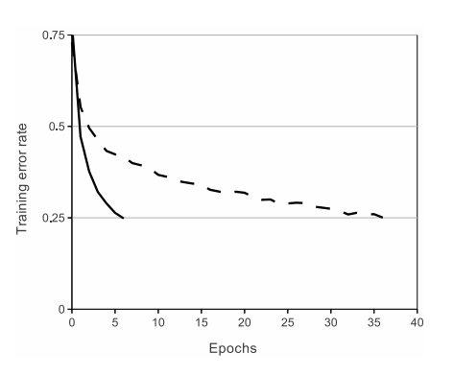
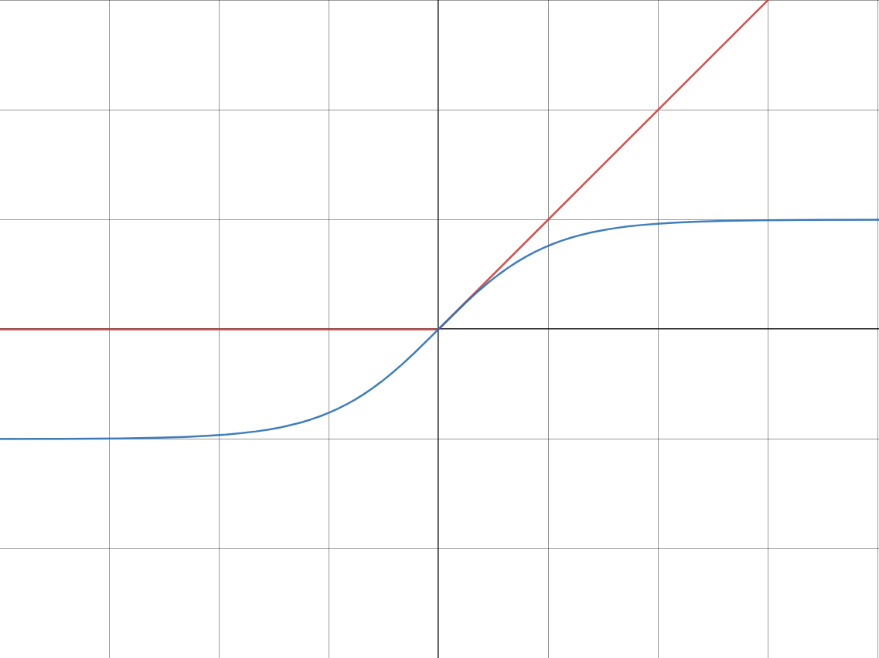
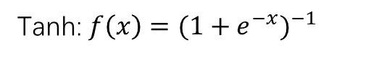
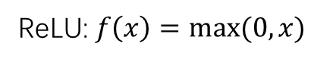
ReLU
Tanh: $f\left(x\right)={(1+e^{−x})}^{−1}$
ReLU: $f\left(x\right)=max⁡(0,x)$

Slide 8
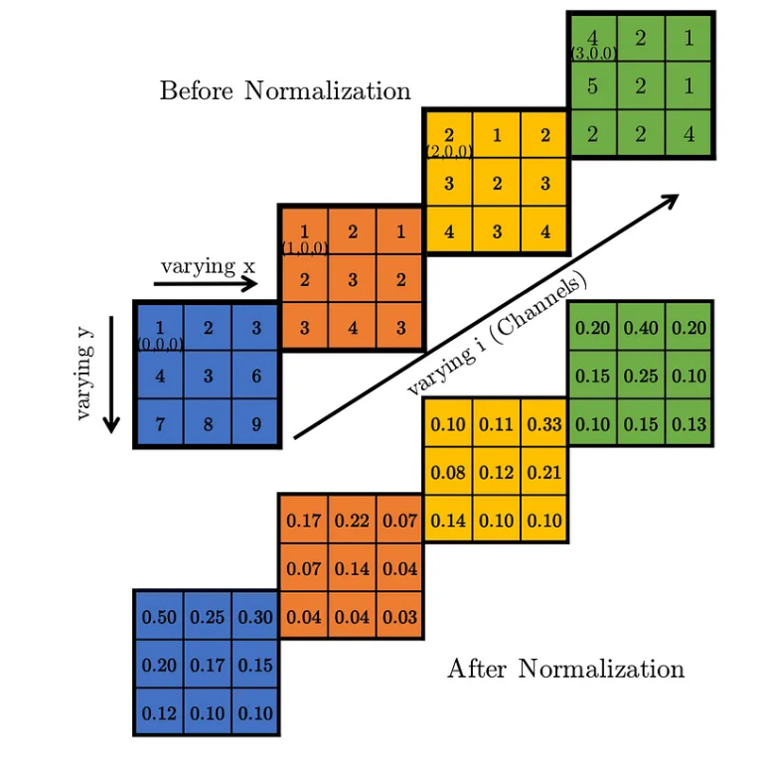
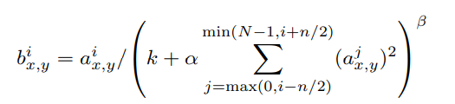
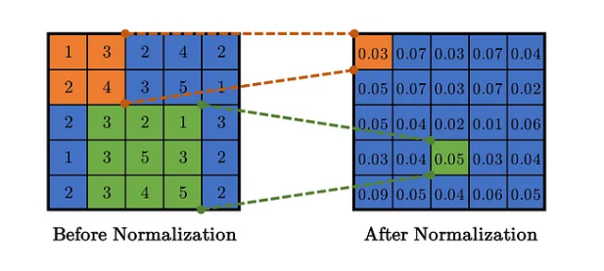
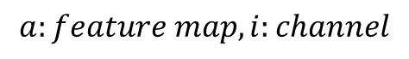
Local Response Norm
Inter-channel:
$$a:feature map, i:channel$$
Intra-channel:

Slide 9
Dropout
output
output
input
input
P:0.5

Slide 10
Visualizing and Understanding Convolutional Networks (ZF Net)
Change kernel size from 11x11 to 7x7, stride from 4 to 2
Visualizing
Features of Convolution

Slide 11
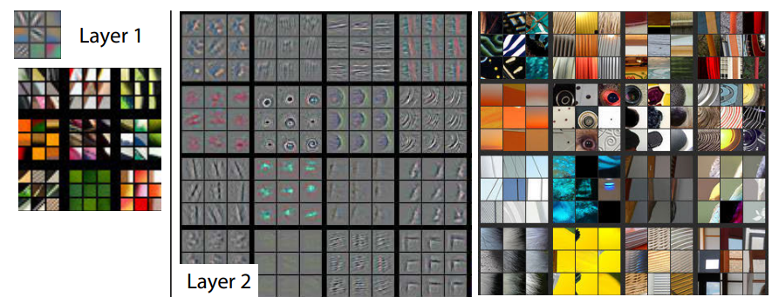
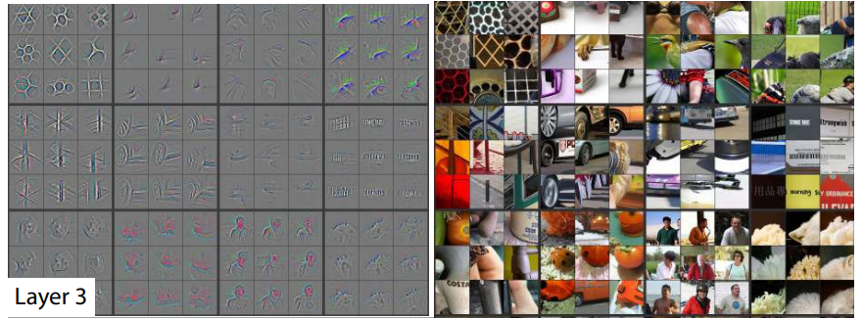
Visualizing

Slide 12
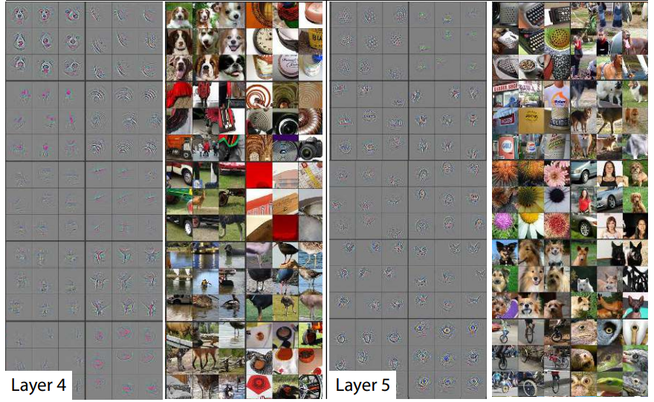
Visualizing

Slide 13
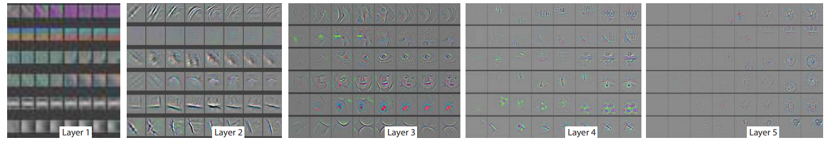
Visualizing
Evolution of a randomly chosen subset of model features through training: [1,2,5,10,20,30,40,64]
Low-level feature
High-level feature

Slide 14
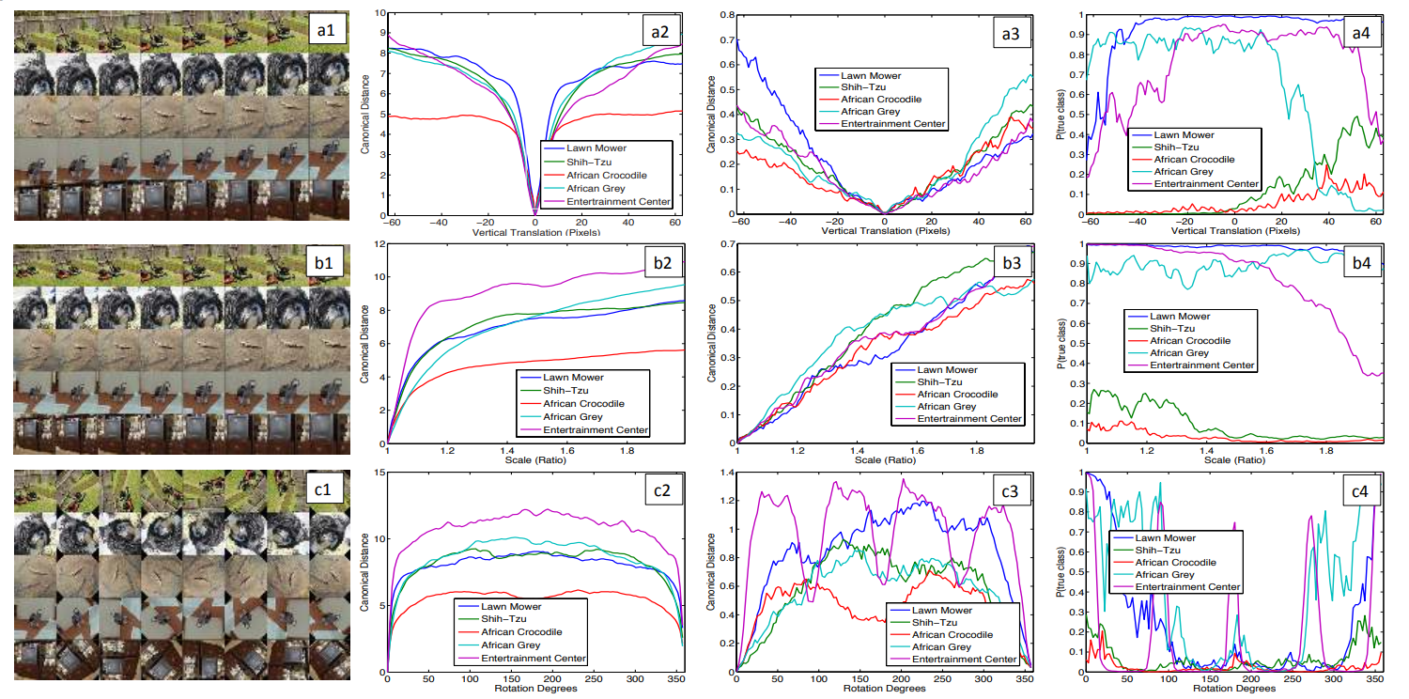
Features of Convolution
Feature map’ s Euclidean distance in 1st conv layer.
7th conv layer
Acc
Vertical:
Scale:
Rotation:

Slide 15
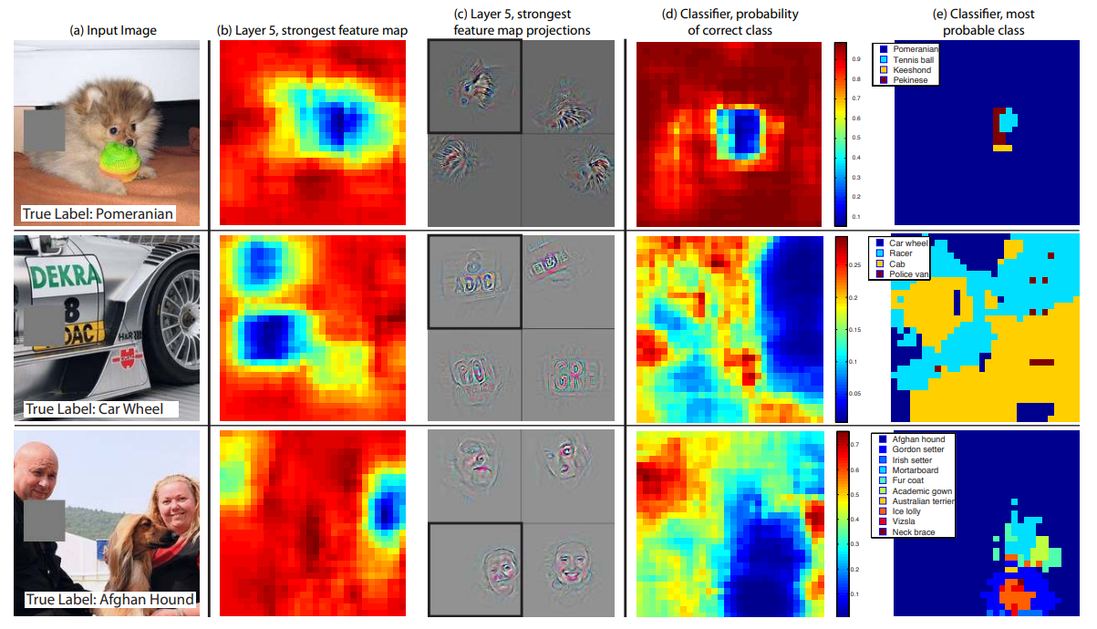
Features of Convolution

Slide 16
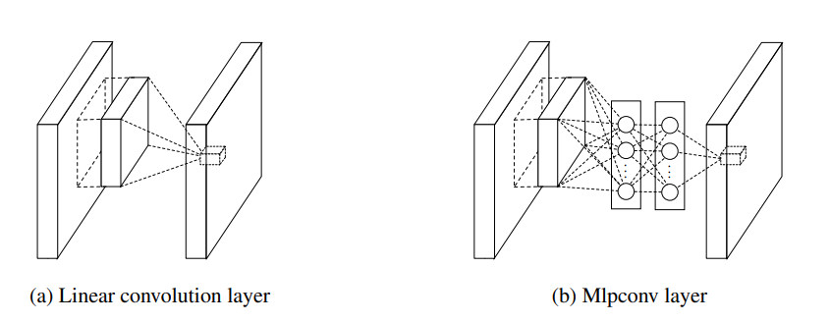
Network in Network
Mlpconv layer
Global Average Pooling

Slide 17
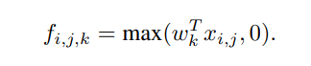
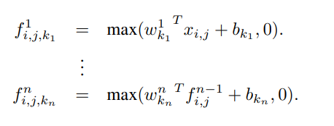
Mlpconv layer
Compare with (a), (b) introduce MLP in conv layer, which bring more non-linear property here, make ease to learn feature.

Slide 18
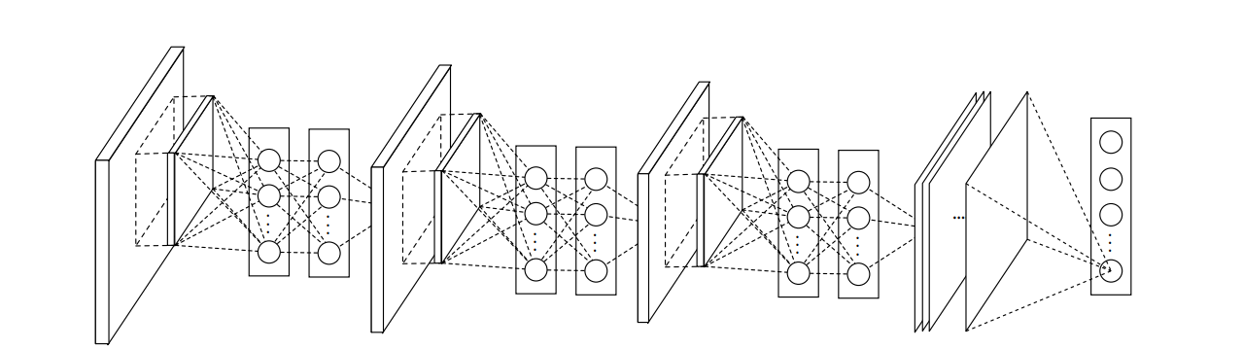
Global Average Pooling
Instead of fully connected layer, NiN use GAP follow Mlpconv layer. Compare with FC layer, GAP layer is no parameter to optimize, and it’s more robust, Also avoid overfitting.
But, GAP layer is slower in convergence, may because of here is no parameter. So Network must do more optimize in Mlpconv layer.

Slide 19
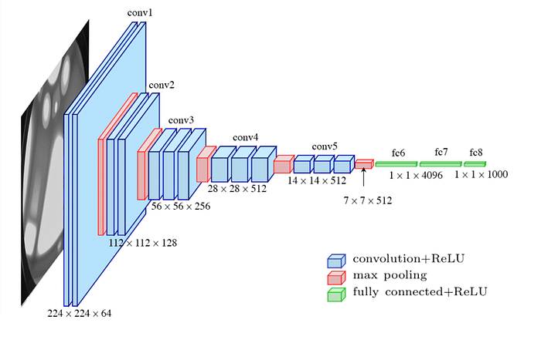
VGG
Evolution from AlexNet
Architecture

Slide 20
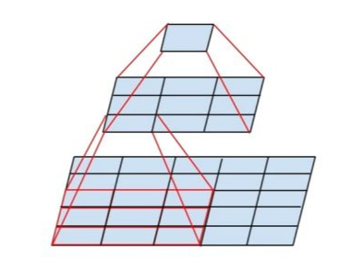
Evolution from AlexNet
Replace by 3x 3x3 conv
Replace by 2x 3x3 conv
Also utilise 1 × 1 convolution filters, which can be seen as a linear transformation of the input channels

Slide 21
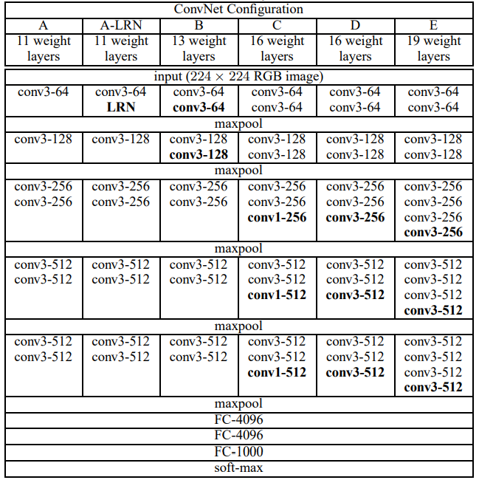
Architecture

Slide 22
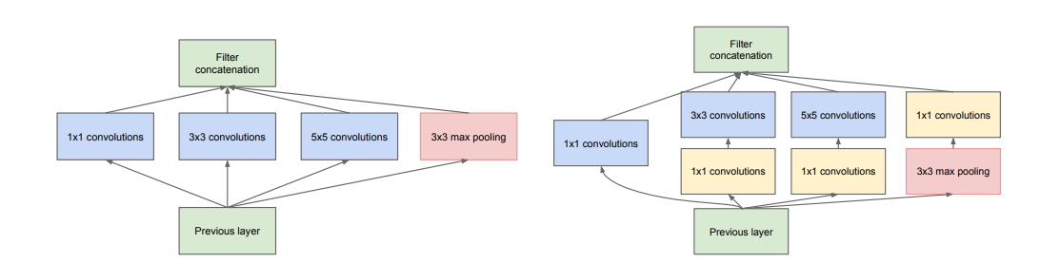
GoogLeNet(Inception v1)
1x1 convolution
Inception module
Architecture

Slide 23
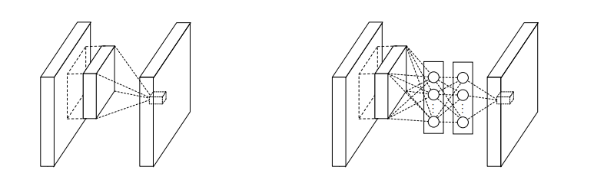
1x1 convolution
Normal conv op
1x1 conv after 3x3 conv
1x1 conv introduce more non-linear property, also reduce the dimension of feature map.

Slide 24
Inception module
Each part aggregate different scale of features, then concatenation them.
First version of Inception module.
Introduce 1x1 conv to reduce the complexity of computation.

Slide 25
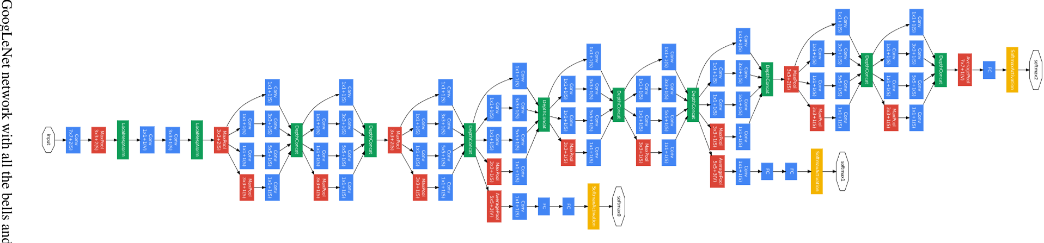
Architecture
Auxiliary classification head, discard when end of train.

Slide 26
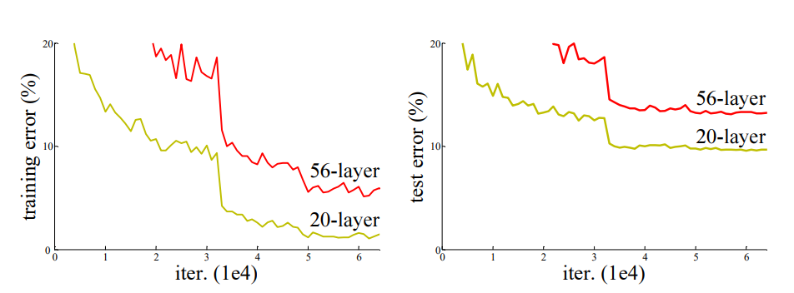
ResNet
Degradation problem in deep network
Residual Module
Error surface
Architecture

Slide 27
Degradation problem in deep network
With the network depth increasing, accuracy gets saturated and then degrades rapidly. Unexpectedly, such degradation is not caused by overfitting, and adding more layers to a suitably deep model leads to higher training error.
Better initialization, Optimizer.
That’s mean, the deeper network is harder to find optimal solution in training.
Change the structure of network to make better error surface.(ResNet)

Slide 28
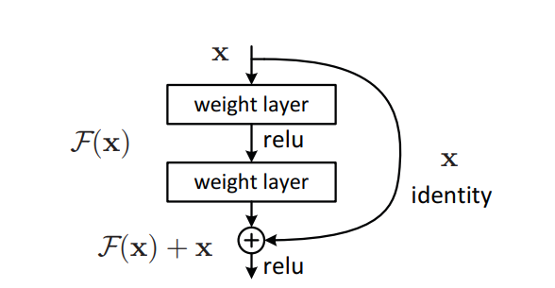
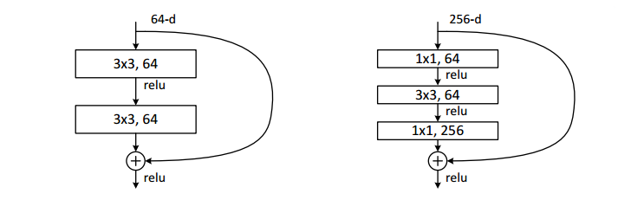
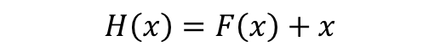
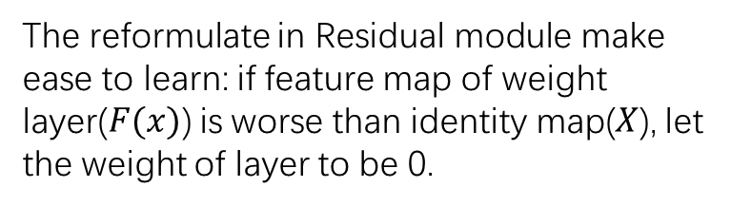
Residual Module
$$H\left(x\right)=F\left(x\right)+x$$
The reformulate in Residual module make ease to learn: if feature map of weight layer($F(x)$) is worse than identity map($X$), let the weight of layer to be 0.
Basic Block
Bottleneck Block

Slide 29
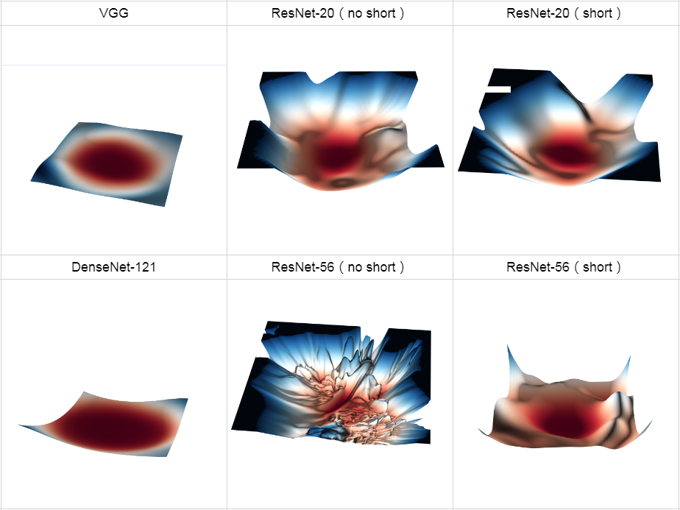
Error surface

Slide 30
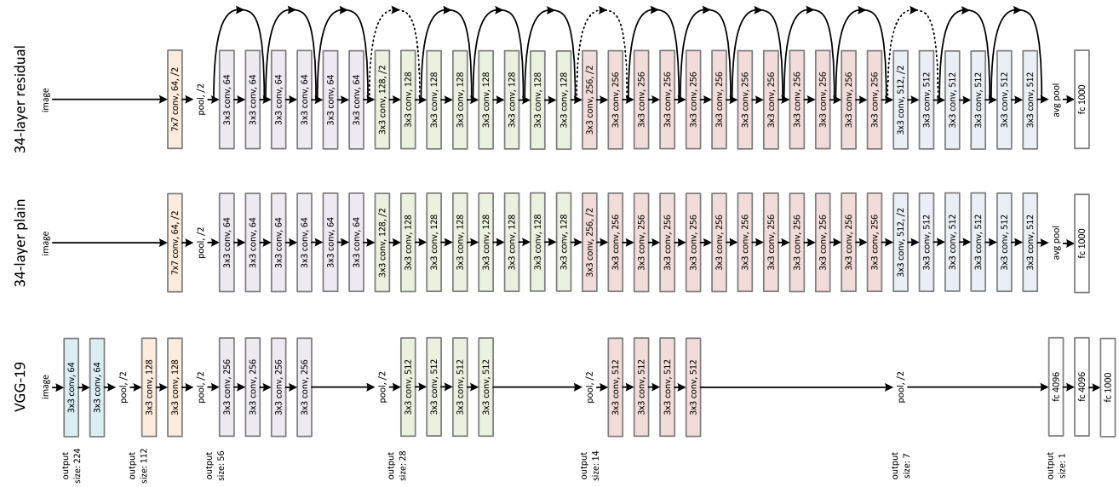
Architecture

Slide 31
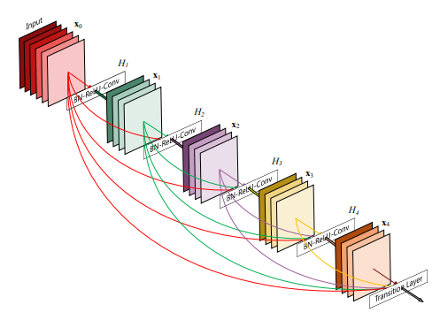
DenseNet
Dense Block
Architecture
Connection in Dense Block

Slide 32
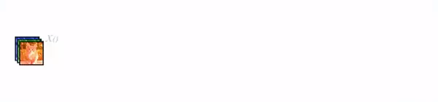
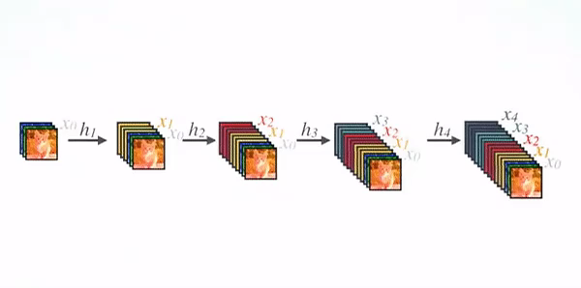
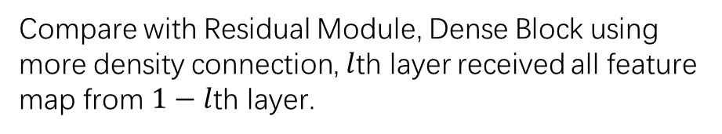
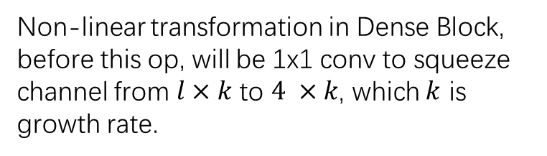
Dense Block
Instead of element-wise addition, Dense Block concat all feature map from previous layer.
Concat feature map through channel.
Compare with Residual Module, Dense Block using more density connection, $l$th layer received all feature map from $1−l$th layer.
Non-linear transformation in Dense Block, before this op, will be 1x1 conv to squeeze channel from $l×k$ to $4 ×k$, which $k$ is growth rate.

Slide 33
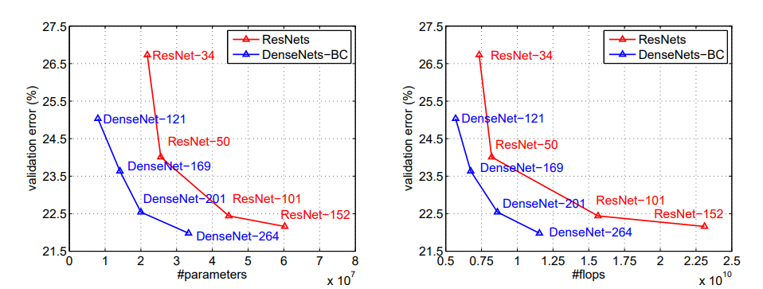
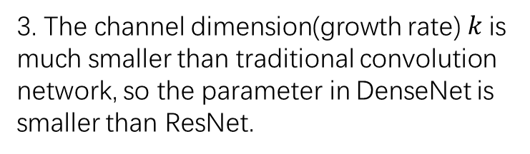
Dense Block
3. The channel dimension(growth rate) $k$is much smaller than traditional convolution network, so the parameter in DenseNet is smaller than ResNet.
1. More connection means more powerful gradient flow, it can avoid gradient vanished. And also built deep supervised from FC layer.
2. These density connection can aggregate feature map from all previous layer, which means reuse of feature map and keep low-level feature.

Slide 34
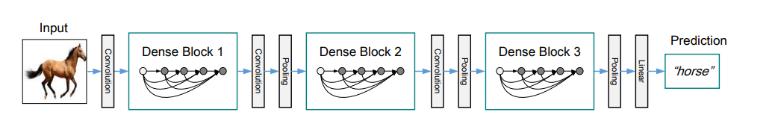
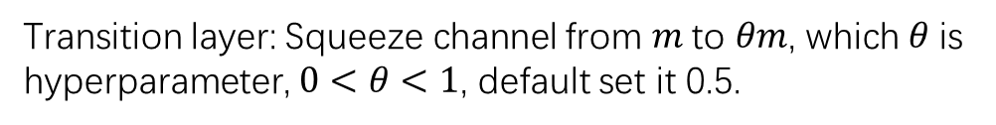
Architecture
Transition layer: Squeeze channel from $m$to $θm$, which $θ$is hyperparameter, $0<θ<1$, default set it 0.5.

Slide 35
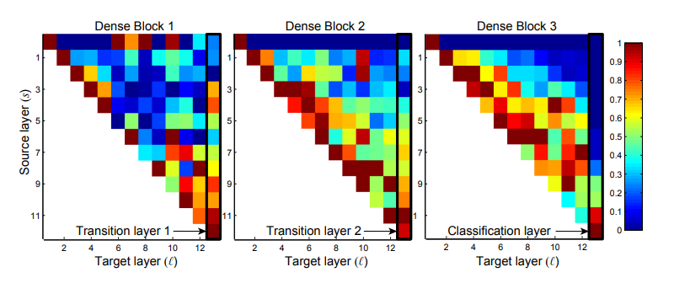
Connection in Dense Block
Heatmap of connection
Least weight of Transition layer in block2 & 3

Slide 36
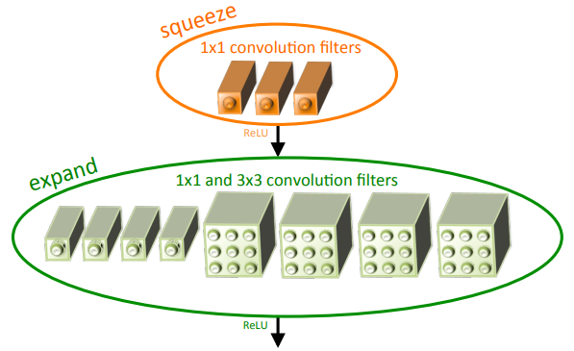
SqueezeNet
Strategy of design CNN
Fire module
SqueezeNet
Analyze of SqueezeNet

Slide 37
Strategy of design CNN
Microarchitecture
Strategy 1. Replace 3x3 conv with 1x1 conv.
Strategy 2. Decrease the number of input channels to 3x3 conv.
Strategy 3. Downsample late in the network so that convolution layers have large activation maps.
Macroarchitecture

Slide 38
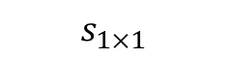


Fire module
$$s_{1×1}{<e}_{1×1}+ e_{3×3}$$
$$s_{1×1}$$
Strategy 2
(hyperparameter about number of channel)
$e_{1×1}$,${ e}_{3×3}$
Strategy 1
1x1
1x1
3x3
Channel concat

Slide 39


SqueezeNet
SqueezeNet
SqueezeNet with simple bypass
SqueezeNet with complex bypass

Slide 40


Analyze of SqueezeNet

Slide 41

Inception-V2
General Design Principles
Factorizing Convolutions
Architecture

Slide 42
General Design Principles
Avoid representational bottlenecks, especially early in the network.
Higher dimensional representations are easier to process locally within a network.
Spatial aggregation can be done over lower dimensional embeddings without much or any loss in representational power.
Balance the width and depth of the network. Optimal performance of the network can be reached by balancing the number of filters per stage and the depth of the network.

Slide 43



Factorizing Convolutions
Original Inception module
New Inception module-1
5 $×$5 conv replace by two 3 $×$3 conv, keep same inception field while save cost in computation. Also followed principle 3.

Slide 44



Factorizing Convolutions
Factorize 3 $×$ 3 conv into 3 $×$ 1 and 1 $×$ 3 conv(Asymmetric Convolutions).
It’s 33% cheaper for 3 $×$ 3 conv.
New Inception module-2(n=7)

Slide 45


Factorizing Convolutions
Inception module that reduce kernel size while expand channel. Without violate principle 1.
New Inception module-3(in practice).
Followed principle 2.

Slide 46




Architecture

Slide 47

Inception-V4, Inception-ResNet-V1,V2
Inception-V4
Inception-ResNet-V1
Inception-ResNet-V2
Compare in Reduction module & Experiment

Slide 48

Inception-V4
Asymmetric conv
Like Inception-V2, using 3x3 conv mainly.

Slide 49


Inception-V4
I,K,N,M denote hyperparameter;
V means scale down of feature map.

Slide 50


Inception-V4
= two 7x7 conv and 1x1 conv, but cheaper.

Slide 51

Inception-V4

Slide 52


Inception-ResNet-V1
Inception-ResNet-V1 is match for Inception-V2/V3 in number of parameter.

Slide 53


Inception-ResNet-V1

Slide 54


Inception-ResNet-V1

Slide 55

Inception-ResNet-V1

Slide 56

Inception-ResNet-V2
Stem in Inception-ResNet-V2 is same as Inception-V4.
Inception-ResNet-V2 is match for Inception-V4 in number of parameter.

Slide 57


Inception-ResNet-V2

Slide 58


Inception-ResNet-V2

Slide 59

Inception-ResNet-V2

Slide 60



Compare in Reduction module & Experiment

Slide 61

ResNext
Network-in-Neuron
Aggregate Module
Architecture

Slide 62




Network-in-Neuron
Like a neuron, Aggregate Module also have multiple input and it’s weight. Computing each and aggregate to output.
A simple neuron
Aggregate Module

Slide 63

Aggregate Module
Aggregate Module have multiple paths as Inception, but the path in Aggregate Module have same shape.
Aggregate Module followed the rule inspired by VGG/ResNet:
If producing spatial maps of the same size, the blocks share the same hyper-parameters.
Each time when the spatial map is downsampled by a factor of 2, the width of the blocks is multiplied by a factor of 2.

Slide 64


Architecture
C indicate group number in conv

Slide 65

ShuffleNet
Channel Shuffle
ShuffleNet Unit
Architecture

Slide 66
Channel Shuffle

Slide 67

ShuffleNet Unit

Slide 68

Architecture

Slide 69

Vision Transformer
Image Procession & Linear Projection
Transformer Encoder
MLP Head

Slide 70
Image Procession & Linear Projection
Position Embedding
0
Class Token
*
1
2
Transformer Encoder
L
…
P
n
addition
image
patches
Linear Projection

Slide 71

Transformer Encoder
Linear
There is different in ViT’s Transformer Encoder. In Encoder block, the Multi-Head Attention and MLP layer is after LayerNorm
Dropout
GeLU
Linear
MLP Layer

Slide 72
MLP Head
MLP Head just take the first output of Transformer Encoder as input(class token).
But in practice, usually use mean pooling on output.
MLP Head
Transformer Encoder
…

Slide 73

Swin Transformer
Architecture
Window-MSA
Shifted Window
Relative position bias

Slide 74

Architecture
Swin Transformer task by 4 stages, stage 1 stack by Linear Embedding and Swin Transformer Block(ST block), other stack by Patch Merging and ST block.
A ST block consist of 2 successive Transformer Encoder block, which alternate the MSA by W-MSA and SW-MSA.

Slide 75


Window-MSA
Merging
Different from ViT and other visual Transformer, Swin Transformer uses the window self-attention to reduce the computing size, which just focus on local patch, and merging these patch on Patch Merging Layer after ST block to get global relation.
Gary means patch, Red means attention window

Slide 76


Shifted Window
For get information between neighboring window and reduce the computing size, Swin Transformer uses top-left cyclic shift on Shifted-Window-MSA after Window-MSA.
In Shifted-Window, only identical partition will be computing, different partition in same patch will be masked when computing self-attention.
Notes:
https://blog.csdn.net/weixin_42715977/article/details/124151870

Slide 77



Relative position bias
Swin Transformer introduce Relative positing bias in W-MSA and SW-MSA, and $B$ is taken from $\hat{B}$, a smaller-sized bias matrix.
Notes:
https://blog.csdn.net/qq_37541097/article/details/121119988

Slide 78

VisualBert
Produce image feature with Fast R-CNN or other network
Like ViT, VisualBert interact image feature and text to Bert.

